Slide 2
Vector Databases
Copyright © 2024 BOGA AI, Inc. All rights reserved.

Slide 3
Why Vector Database
LLMs can be Hallucinated for our own data.
LLMs may not have up-to date information(Trained few months/days ago)
Overcome the Context window limitations.
Act as Long Term Memory (Semantic information).
(Add knowledge to LLM)
TO Store vector embeddings(Contextual,Patterns and its Relationships in the data.)--Traditional databases lacs.
2024 BOGA AI, Inc.

Slide 4
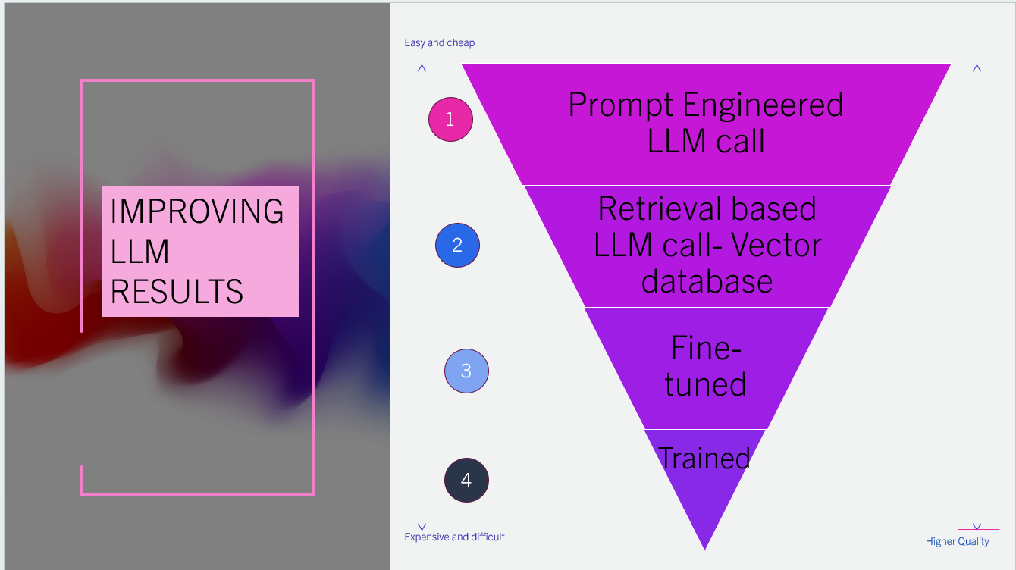
Vector Database
2024 BOGA AI, Inc.

Slide 5
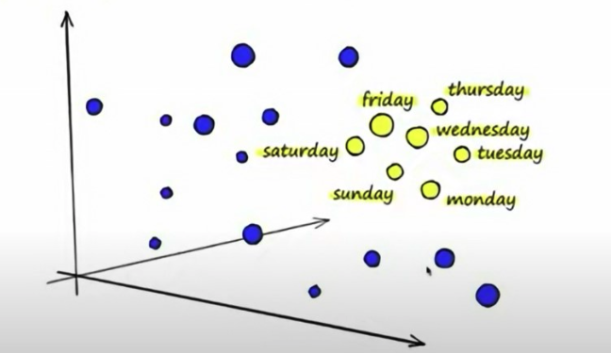
Vector database
Specialized databases for storing and managing vector representations of given text/document.
Represents a information in n-dimensional vector spaces
Optimized for querying information based on semantics, not just based keywords.(Traditional DBs).
Documents that are related
2024 BOGA AI, Inc.

Slide 6
Vector vs Traditional vs Graph Databases
Traditional Database | Vector database | Graph database
Stores Strings, Numbers | Vectors/Embeddings | Entities and Relationships
Rows & Columns,KV,Documents | Vector Space | Nodes and edges
Exact Match Search for Rows | Similarity Search on Vectors( Nearest neighbors) | Graph traversal and pattern matching
INDEX-BASED Search | Cosine similarity Euclidean distance Dot product | Hierarchical, Parent-Child
Queries are optimized using Indexes. | Queries are optimized using ANN algorithms through hashing, quantization, or graph-based search. | Efficient handling of complex relationships, flexible schema
vector database
graph database
2024 BOGA AI, Inc.

Slide 7

Vector database pipeline
Contents/data
text,doc,image,video
1
Embedding Model
Vector database
(Indexes)
Vector embedding
[1.1,20.1.34……0.5,1,1]
3
Query(text,image,video)
2
Applications/Prompt
5
4
Context==> ( query +vector result)
context
LLM Apps:
Contents generation
Text summarization
Classification/Entity recognition/ Sentiment analysis
Q&A
Applications:
Semantic Search
Similarity Search
Recommendation
Anomaly detection
ML model optimization
..
Answer
LLM
6
2024 BOGA AI, Inc.

Slide 8
Popular databases in the market
Top 15 Vector Databases that you Must Try in 2024
Vector Databases Categories
Traditional databases with vectors support | Modern Vector data bases | Cloud based Vector database services
Postgres-Pgvector | Pinecone *** | GCP- Vector Search
Redis - RedisSearch | Chroma *** | Azure - Cognitive Search
Mongo - Atlas | FAISS (in-memory) *** | Amazon Opensearch
Elasticsearch - ELSAR | Milvus
2024 BOGA AI, Inc.

Slide 9

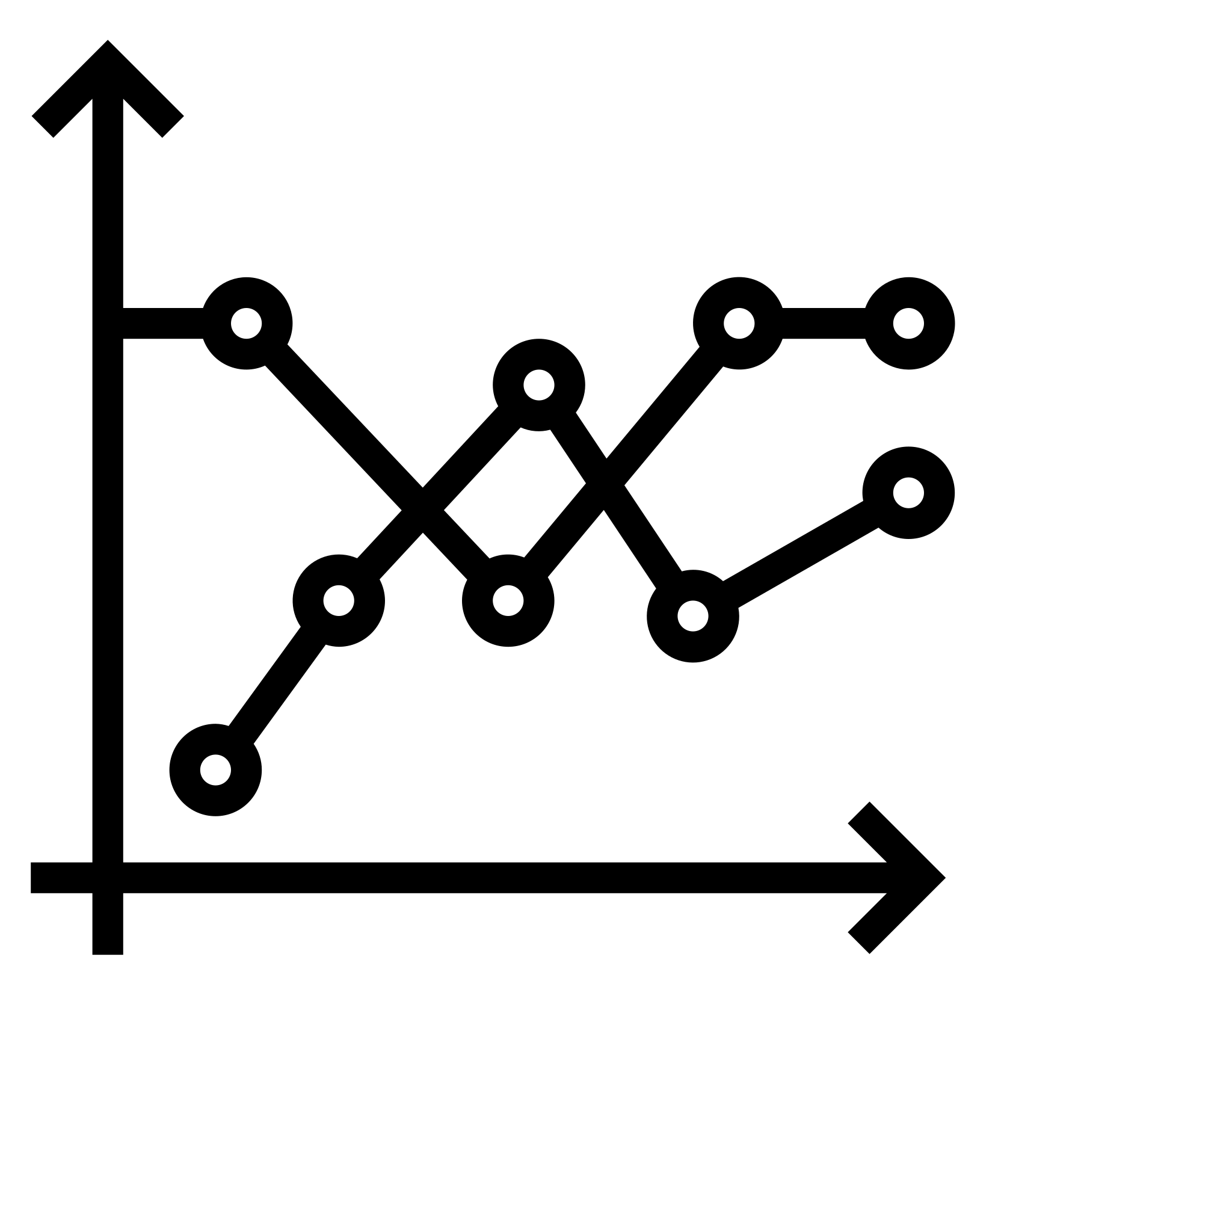
Vector Database Use case
Use case
Have list of documents
Create embeddings using Embedding model and store into vector database
Get user input (prompt)
Retrieve relevant documents(context)
Send context to LLM
Get the answers for user query
App User Prompt 5 MODEL 6
Queries LLM Context Window —-------> Answer
Documents
1 3
context={query +vector result)}
Generate Embedding
4 Fetch Relevant documents
2
Chroma or Pinecone or Faiss or Vector Search
Documents
Embeddings
Vector database
Input text from doc
[1,0.2.3.4.5.6.67.8.10]
2024 BOGA AI, Inc.

Slide 10
Vector Database demo
Chroma DB (Local)
Pinecone (API -key required) ******
FAISS – In-memory
Vector Search - GCP based
Neo4J - Graph database – GraphRAG
2024 BOGA AI, Inc.

